Slide 1
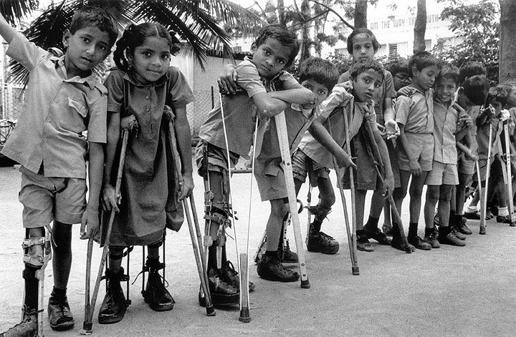
Polio Virus
Polio virus has no effect on about 75% of humans.
About 25% have a mild short-term illness.
About 1 / 150 have muscle weakening and paralysis.
Polio can spread from person to person through the air.
Polio was historically present, but poor sanitation lead to many less powerful forms of the virus. Young children would generally acquire a weak form and develop immunity.
As sanitation improved, polio virus became stronger.
Major outbreaks began around 1900.

Slide 2
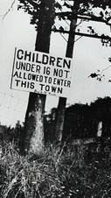
The 1916 New York City Epidemic
Polio occurred primarily in summer months.
Approximately 9,000 people in NYC showed major symptoms, mostly children who had no prior exposure.
About 2,000 people died in NYC; across the nation, total deaths were about 6,000.
Quarantines were common, including inspection of all children entering Pennsylvania from New Jersey.

Slide 3
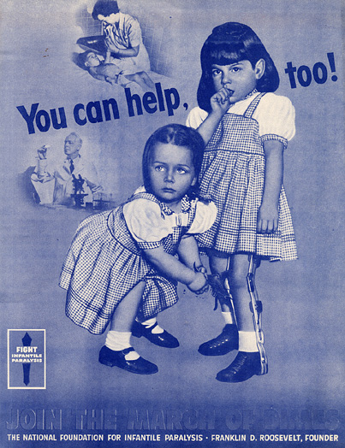
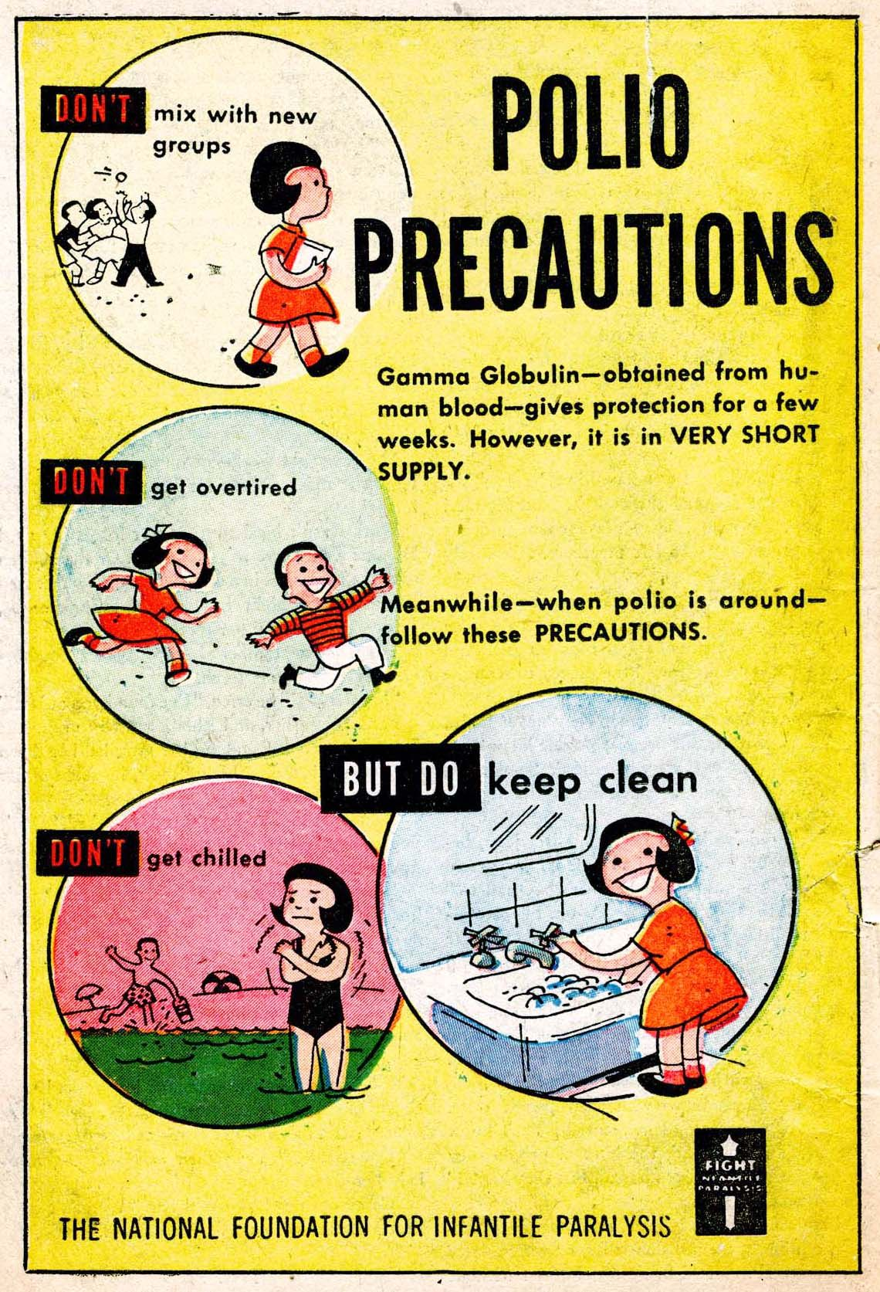
The 1950s Situation
Polio continued to recur, almost every summer.
March of Dimes founded in 1938.
Death rates were reduced, due to better treatment and assistive technology.
In early 1950s, polio caused about 30,000 medical cases per year, with over 1,000 deaths. In 2018, this would be the second-most common cause of death for children ages 1 to 14, behind only accidents.
Video story: https://www.youtube.com/watch?v=gplA6pq9cOs

Slide 4
Field Trials
There had been two vaccine attempts in 1935, but both actually caused some polio, not prevented it.
In January 1953, Dr. Jonas Salk presented small-scale results about an injection of killed-virus vaccine.
The National Foundation for Infantile Paralysis began to plan for a larger study.
School-age children had the highest case rate.
The foundation decided that the sample would consist of children in grades 1, 2, and 3 in 272 US counties with high rates of polio.
Through the winter of 1953-1954, advisory groups met to consider study design.

Slide 5
Observed Control Placebo Control
All Grade 2 students (whose parents consented) would receive a vaccine injection.
Their polio rates would be compared against Grade 1 and Grade 3 students.
Every child in Grades 1, 2, 3 (whose parents consented) would receive an injection.
Half the injections would have vaccine; half the injections would have saline, a placebo injection.
If you were at the advisory group meeting, in the roles given to your group, which approach would you support? Observed Control, Placebo Control, or something else?
You may consider test effectiveness, cost, potential side effects, safety, and any other factors you find relevant.

Slide 6
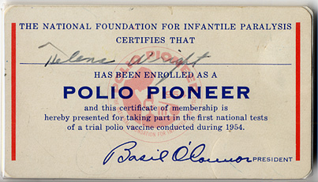
Group Roles and Decisions
Statisticians
Government of New York State High polio fear, strong public health office
Government of Indiana Lower polio fear, budgetary constraints
Parents of Grade 2 Students
Parents of Grade 3 Students
Ethicists

Slide 7
Decisions Made and Non-Response
Observed control was used in 34 states, with about 225,000 vaccines and 725,000 controls.
Placebo control was used in 11 states, with about 200,000 vaccines and 200,000 controls.
There were many concerns about vaccine safety.
Approximately 40% of eligible children did not participate in the placebo trial.
Approximately 30% of eligible Grade 2 children did not participate in the observed control trial.
Wealthier families participated more often, likely because polio affected wealthier families more often.

Slide 8
Results
From observed controls 55 vaccinated cases [25 per 100,000 children] 53 declined cases [43 per 100,000 children] 391 control cases [54 per 100,000 children]
From placebo controls 56 vaccinated cases [28 per 100,000 children] 138 placebo cases [69 per 100,000 children] 153 declined cases [46 per 100,000 children]
Vaccination reduced the incidence rate. “The vaccine works. It is safe, effective, and potent.”

Slide 9
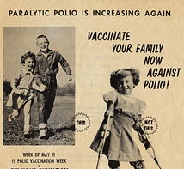
Success!
The press conference on results, 12 April 1955, was nationally televised.
A later oral vaccine made worldwide vaccination much easier and safer.
Vaccination against polio is still part of the recommended schedule.
The last case of polio in the USA occurred in 1979.
In civil wars (Afghanistan, El Salvador, Sudan) truces have been called to allow vaccination.
In 2018, there were only 133 reported cases of polio paralysis, worldwide.

