Slide 1
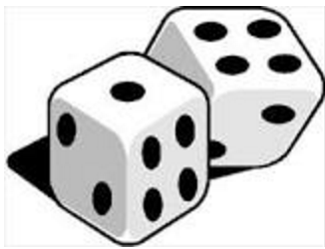
Expectation, Variation and Randomness: Big Ideas linking Chance and Data with Dice

Slide 2
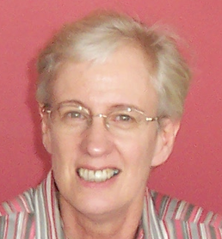
In thinking about how to move student understanding to a higher level related to chance and probability, remember that students may have intuitive ideas or experiences that are different from the theoretical models that are introduced in the secondary curriculum. Telling them that these models apply for fair dice or fair coins may not be enough to dissuade them from their beliefs. What may be required is a statistical investigation to collect real-time evidence supporting the probabilistic model.

Slide 3
This process links the two sub-sections of the Statistics and Probability Curriculum together: Chance and Data representation and interpretation. As well, it illustrates three of the Big Ideas underlying this part of the Curriculum: Variation and Expectation, leading to Randomness. A statistical investigation produces sample data that show variation. The expectation arising from that variation for large samples leads to confirmation of the theoretical probability model, illustrating a random process.

Slide 4
The hypothetical classroom discussion created here considers some number sense issues that are required for successful development of the concepts. The discussion has been recreated from actual classroom experiences and responses to research survey items related to probability. It begins by reviewing students’ understanding of the two Big Ideas of Variation and Expectation, followed by exploring these ideas with an ordinary 6-sided die.

Slide 5
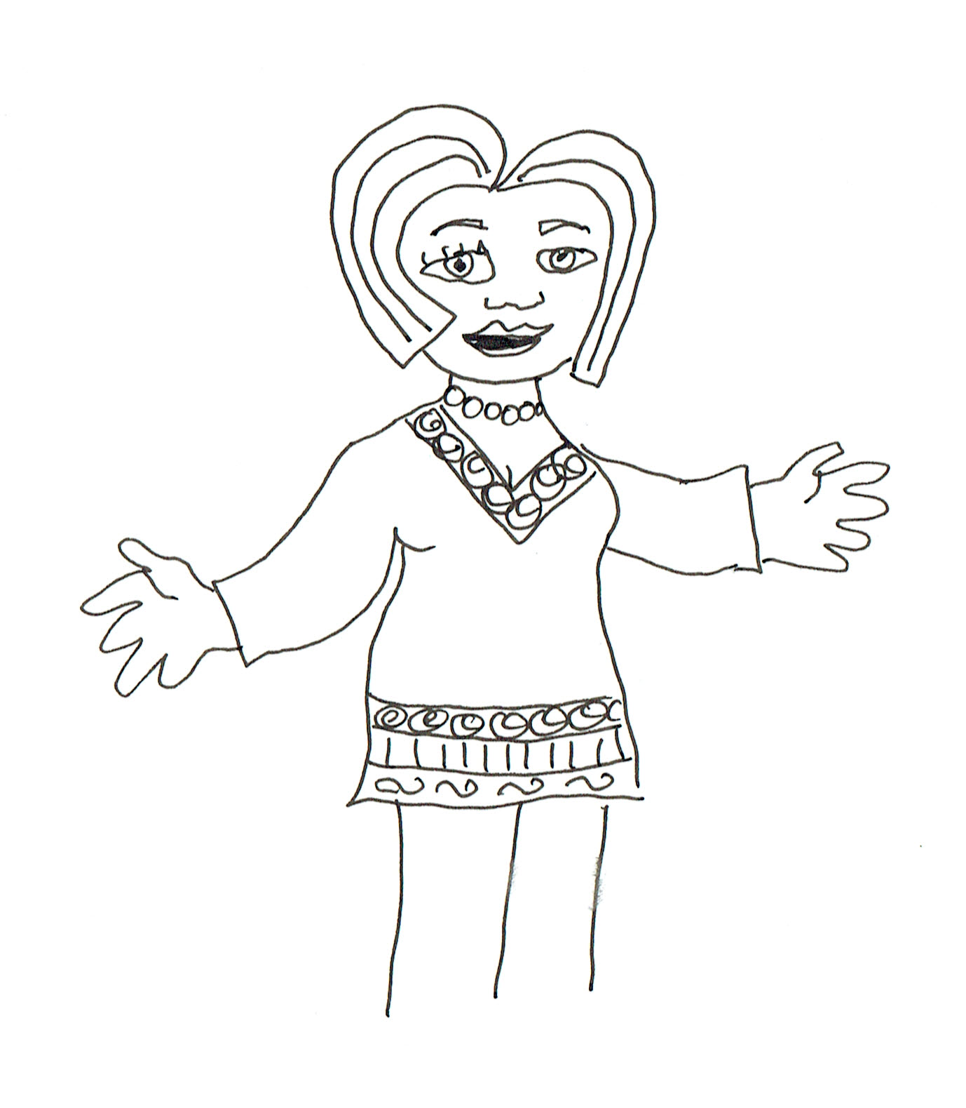
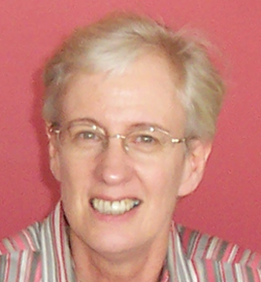
Today we are starting with two Big Ideas in statistics: Variation and Expectation. We are going to explore the Ideas using dice.
Before you start, discuss your definitions of Variation and Expectation. What would your students say?

Slide 6
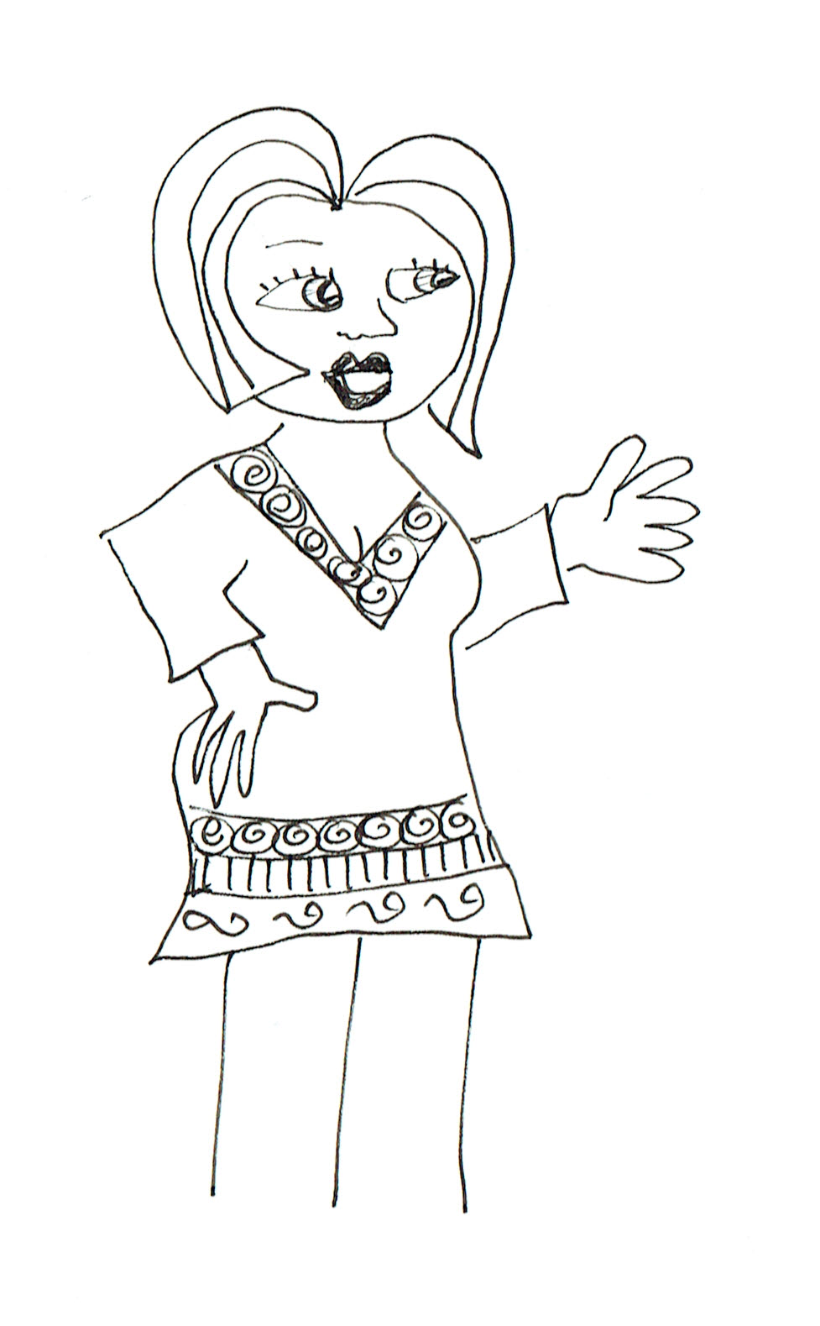
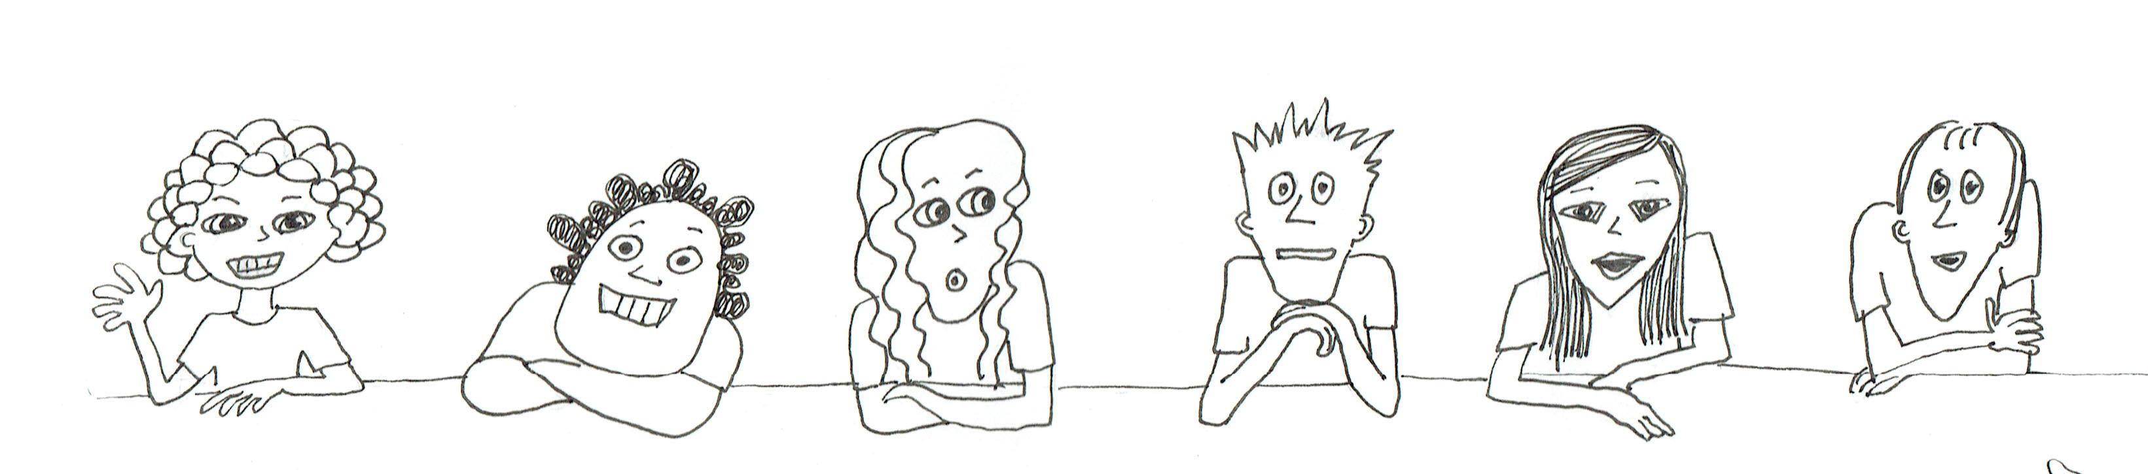
Who can think of some things that vary?
Prime ministers.
Footy scores.
The weather.
Heights of trees.
Moods.
Emma Niko Sophie Jack Mia Riley

Slide 7
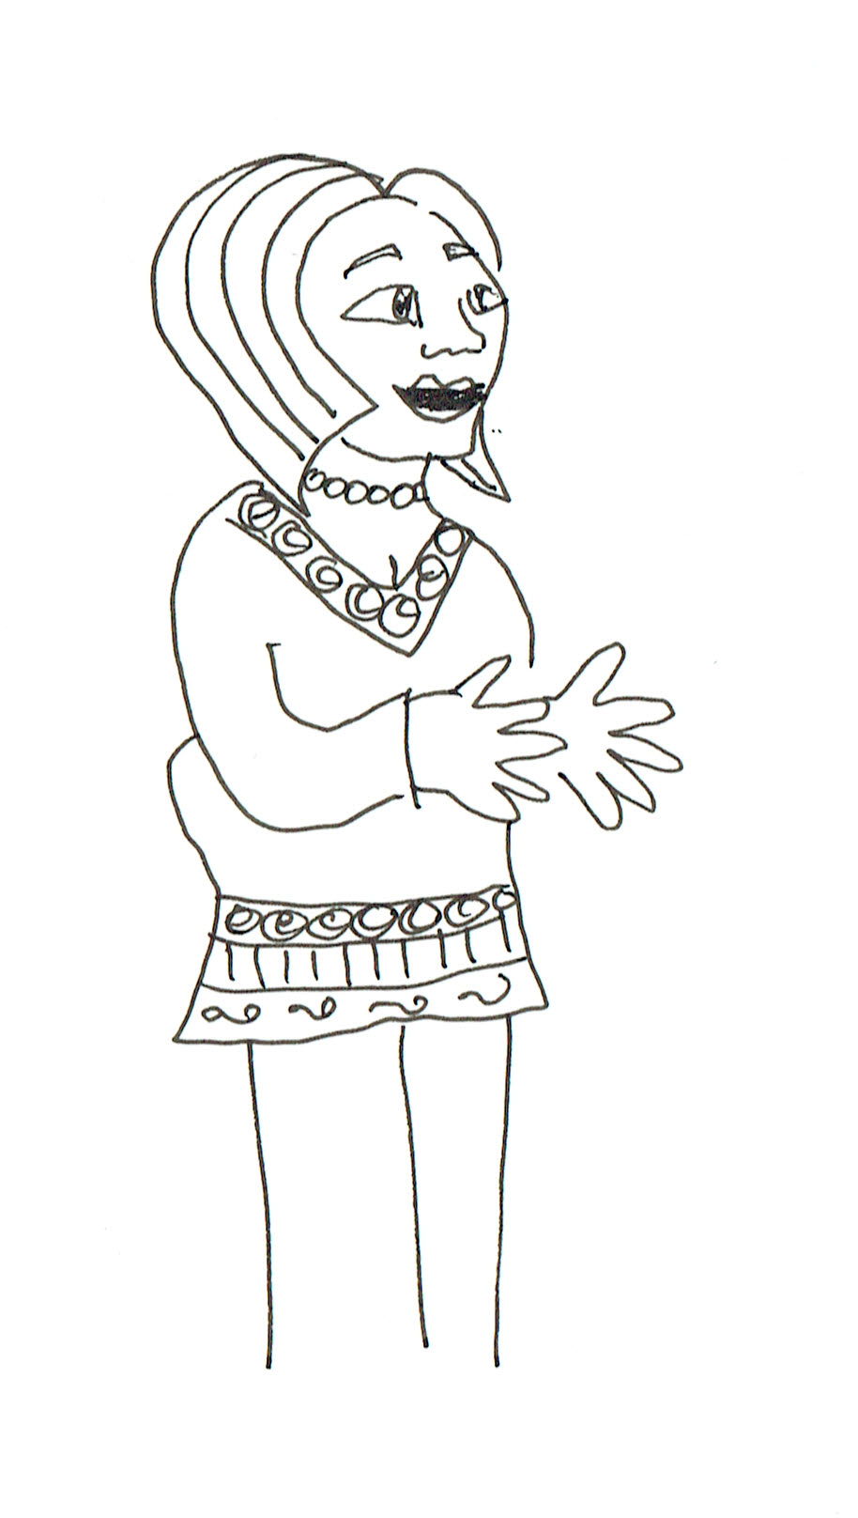
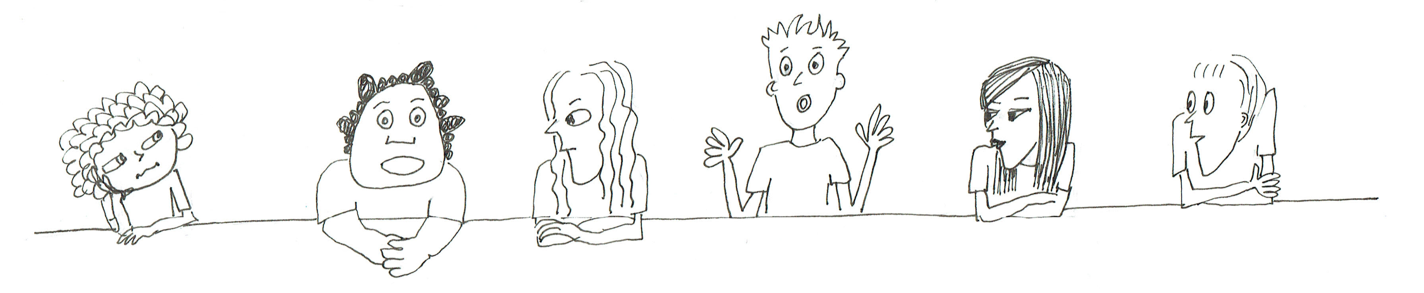
Great examples. Can we think of a definition for variation based on these examples?
Sometimes you can measure the difference with numbers.
It’s like things that change.
Sometimes they vary a lot and sometimes a little.
They aren’t all the same.
Emma Niko Sophie Jack Mia Riley

Slide 8
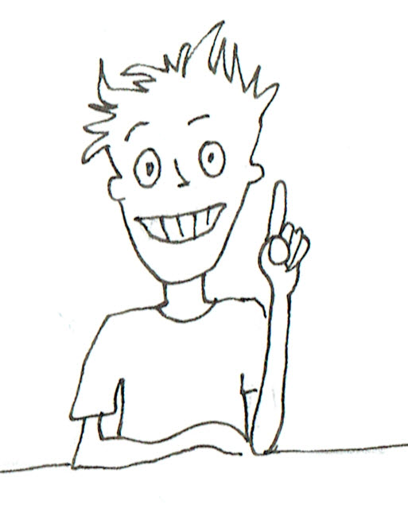
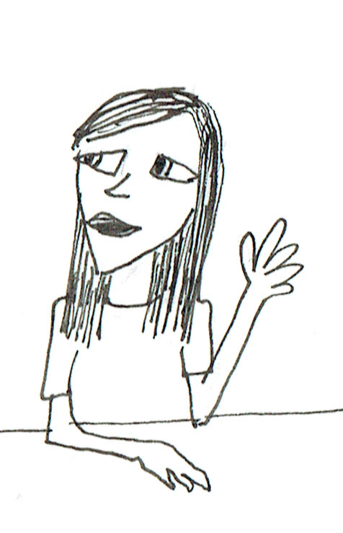
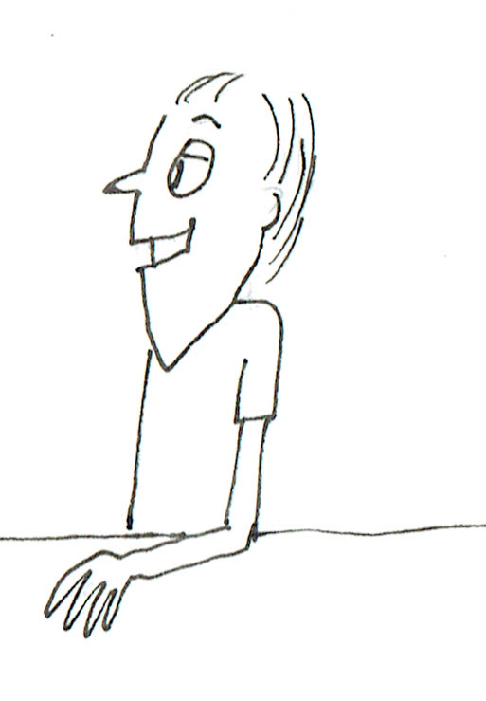
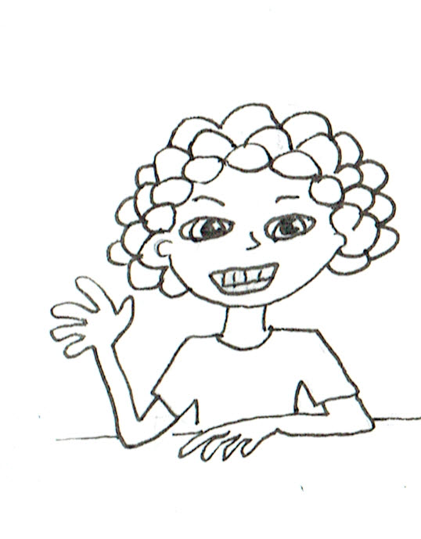
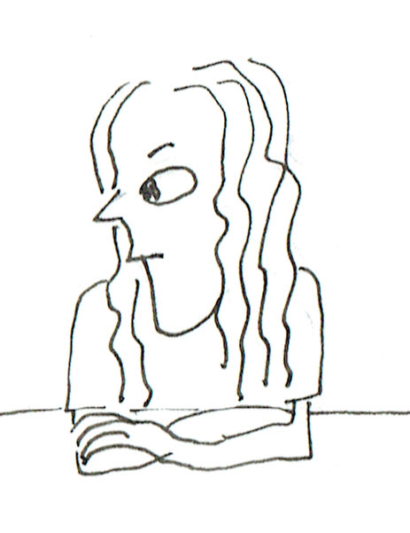
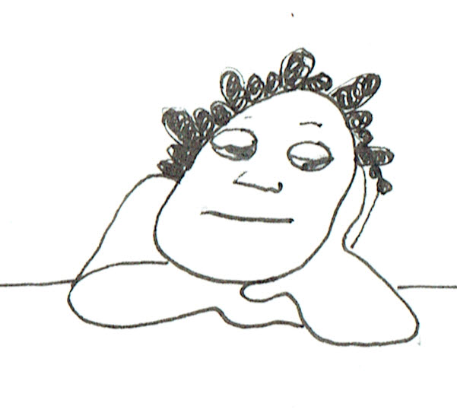
Even though these things change, can you predict or expect what is going to happen?
Polls can predict who wins the election.
I expect my team to win the footy.
Weather forecasters can predict the weather.
I predict that a pine tree is going to grow taller than a shrub.
I expect to feel a lot happier on the weekend with no school!
Emma Niko Sophie Jack Mia Riley

Slide 9
Okay, we want to think about how expectation and variation are related. Can you tell us how your predictions or expectations come out of variation?
How many years would that take?!
I could plant lots of trees and scrubs, take care of them and come back and measure them to see which were taller!!
The weather bureau gets lots of data from different conditions over time and whether it rains or not. Then they tell us what to expect.
Emma Niko Sophie Jack Mia Riley

Slide 10
What about you others?
I look at the past record against the team we’re playing. We win more times than not.
I’d ask 1000 people who they were going to vote for.
Well, 5 days a week I have to think and study and 2 days I mostly relax (if there isn’t any homework).
Emma Niko Sophie Jack Mia Riley

Slide 11
So what is interesting is that even though things vary there are often patterns or trends that let us to predict what can happen. And all of you suggested some kind of data to help make your decisions.
We’ll put a couple of definitions up on the board.
Variation: Change or difference in quantity, level, or condition, often slight.
Expectation: A prediction from variation or summary of variation from data or patterns in data.

Slide 12
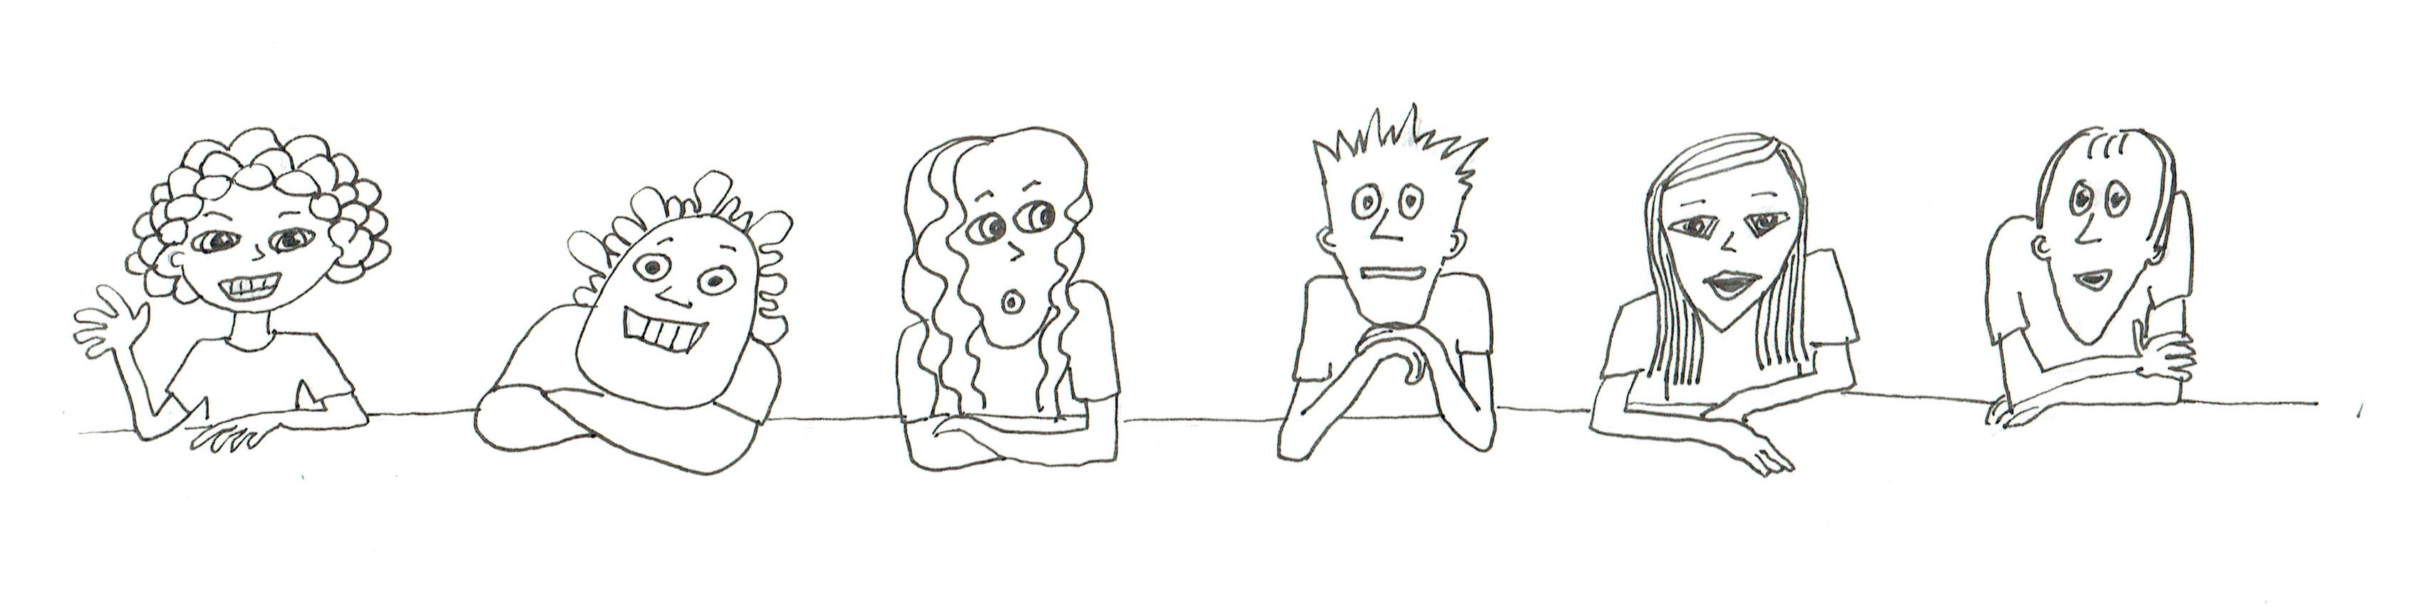
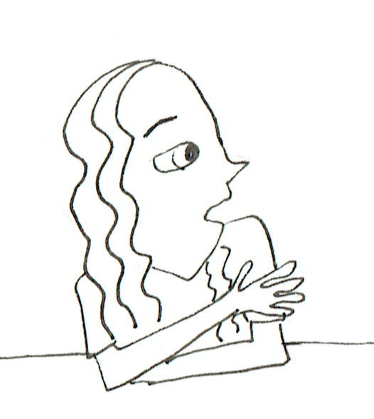
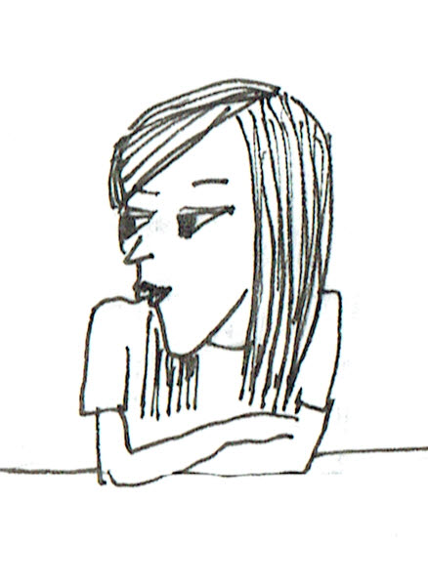
So today we are going to look at throwing a die. What sort of variation do you think we will see?
The numbers 1 to 6.
It could land on its edge.
You get different numbers coming up.
How could that happen?
Like what?
Crack in the table.
Emma Niko Sophie Jack Mia Riley

Slide 13
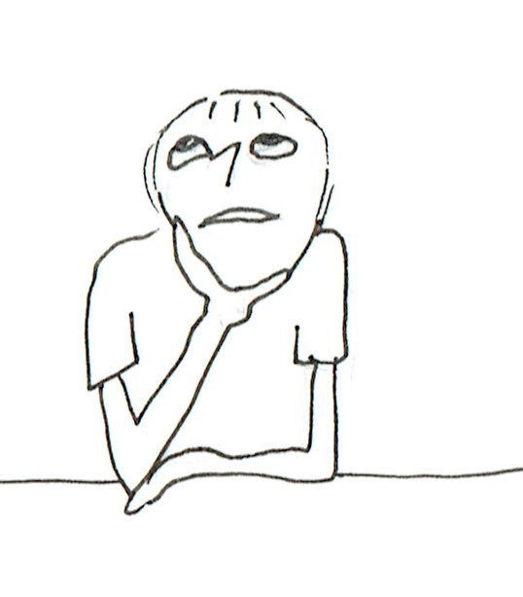
OK, it might land on it’s edge but let’s assume a number comes up. What number and why?
My Dad always gets sixes. I get one’s or two’s. I’m no good at throwing dice.
Especially when you’re starting a game.
Yeah, you never seem to get the number you want.
Emma Niko Sophie Jack Mia Riley

Slide 14
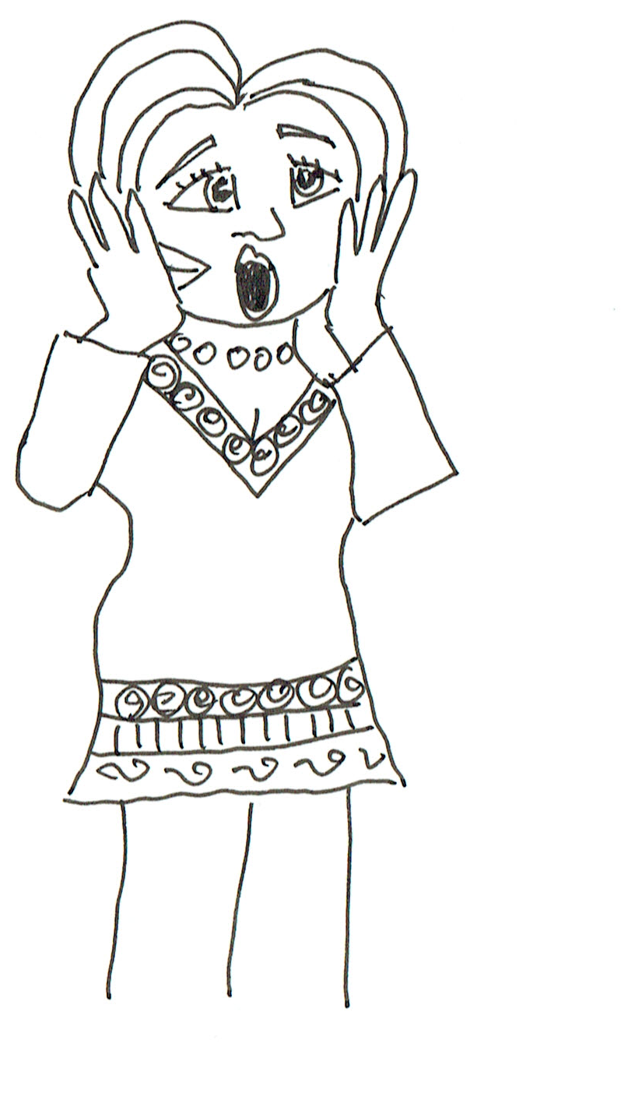
I’d say 4 because it is my favourite number.
AARGHH!
Don’t they understand throwing dice is a random event, not luck?
Well, mostly.
But would it come up all the time?

Slide 15
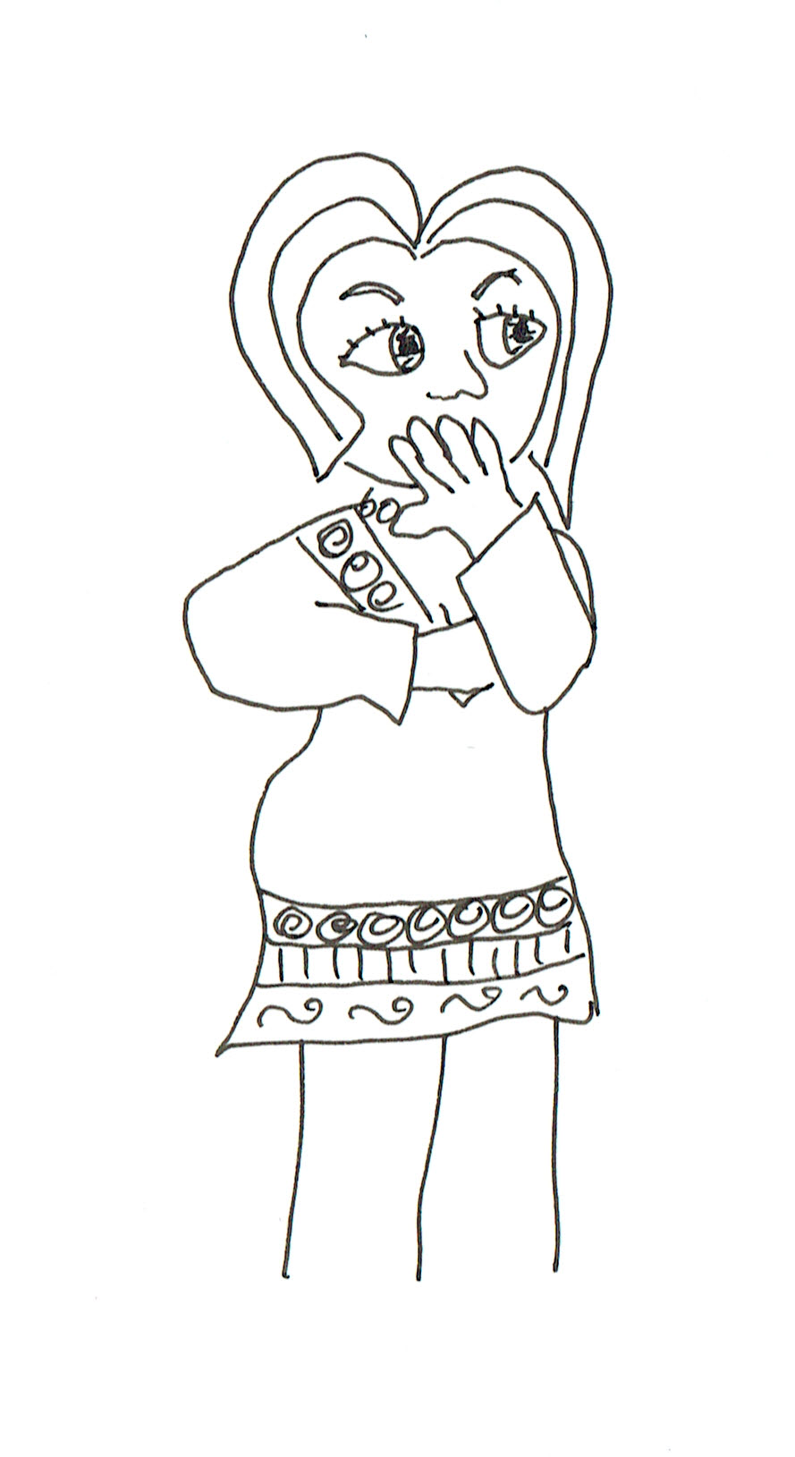
Pause here and think about what the teacher should do next.
Let’s try linking the discussion to “fair” because most of them have an idea of “equal chance” if a game is fair.

Slide 16
So what is important when you play a game with dice?
But what do we mean by fair?
It isn’t biased.
It has to be fair.
Emma Niko Sophie Jack Mia Riley

Slide 17
I could roll it in one dimension so two sides couldn’t come up or so softly only one number would come up.
What do you mean “isn’t biased”?
It needs to be RANDOM!

Slide 18
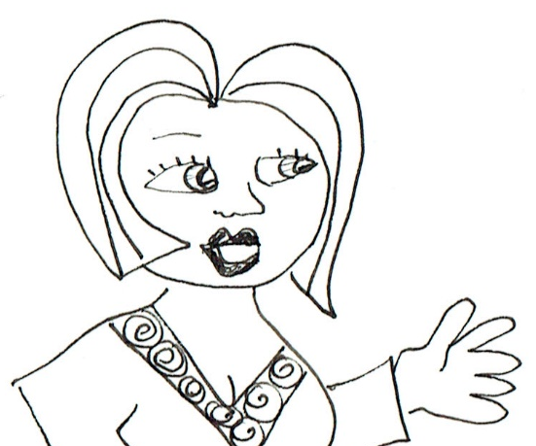
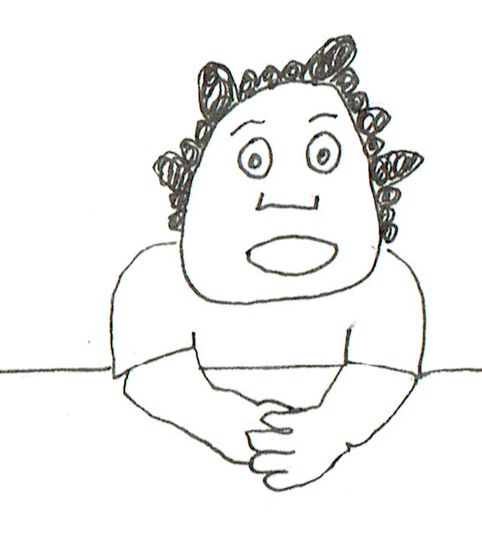
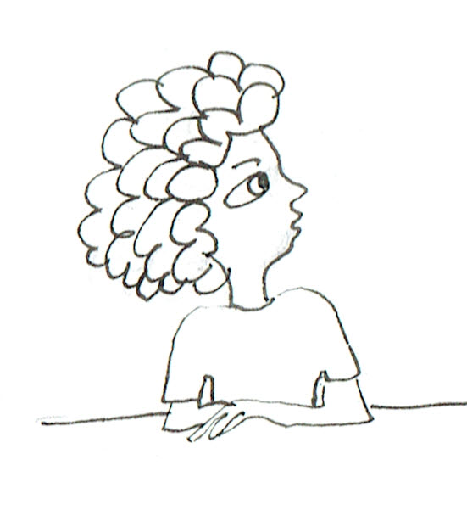
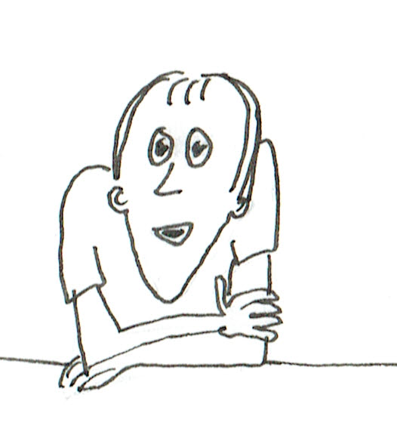
So then, what do we mean by random?
Random is like picking a name from a hat.
But we haven’t got a hat!
It’s like ‘mixed up, not in any order’.
It’s like you don’t know what’s going to happen before you roll a die but to be fair, every side has to have a chance.
I don’t know if ‘random’ is the same as ‘fair’ but for ‘fair’ every side has to have the same chance of coming up.

Slide 19
Okay, maybe we’re starting to get a feeling for Randomness. Turning to our other Big Idea, Expectation, what do we expect when we play a game with dice?
Or when we just toss a die?
We want to make sure they are fair. Even if the outcomes move around randomly, we want them to have the same chance on each side in the long run.

Slide 20
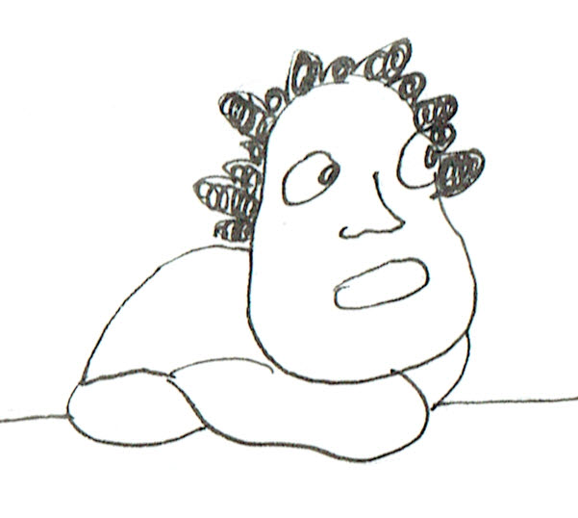
How then do we find out if a die is biased or fair; that is, each side has the same chance of coming up?
Look at it carefully. Is it heavy on one side?
Do the spots for the numbers make the 6-side heavier?

Slide 21
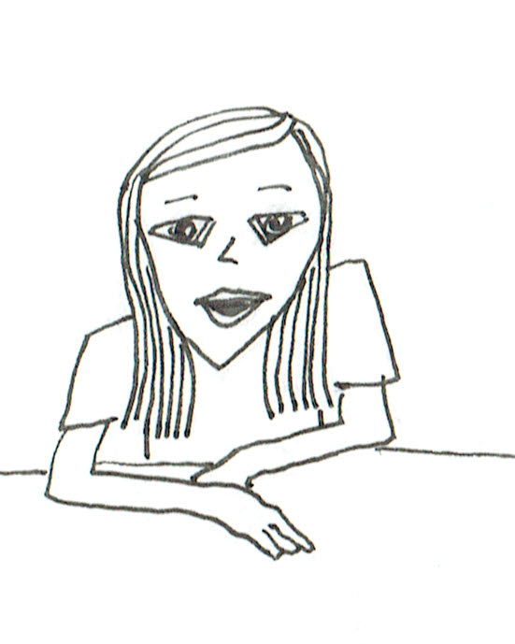
Possibly. So what do we do to test it?
Toss it a few times.
You can’t tell really because sometimes it doesn’t turn out that way.
It’s really the luck of the draw. You might get a run of 6s but then probably the next time you get a run of 1s. It just depends, sometimes it might come up more often but the next time it won’t.
But the chance is supposed to be equal.

Slide 22
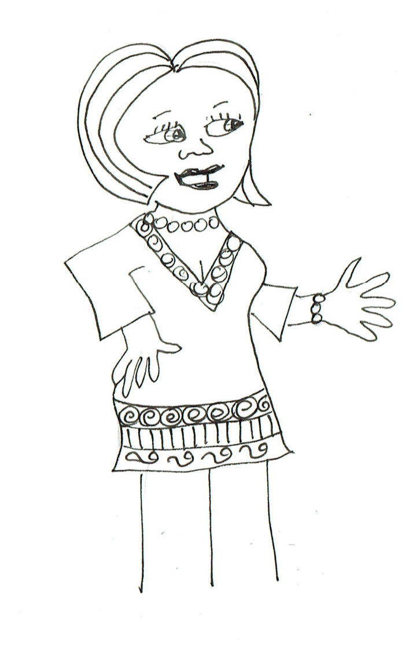
Who says????
Stop and ask yourself what you would say.
When we did fractions, it was 1/6 chance for each side to come up. There are 6 sides so 1/6 for each. If the die has sides that are square and perpendicular to each other, and you throw it fair-like, it should be true.

Slide 23
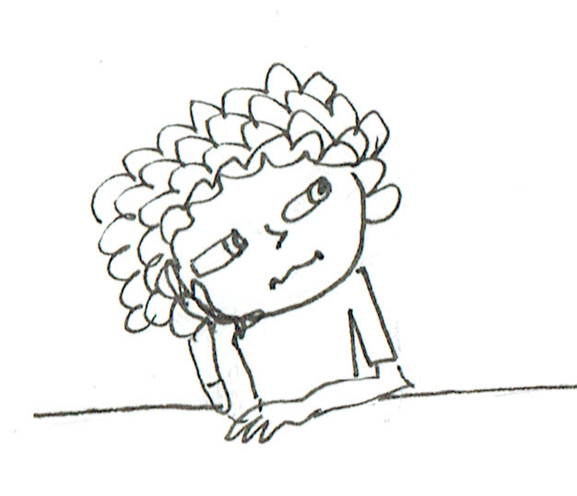
Okay, you are going to test this with some dice. How many times do you think we should toss them? Six? A number to make it easy to work out if each side has an equal chance?
I think 6 isn’t enough. Like Riley said, you might get a few of one in a row so it has to have time to even out. Maybe a multiple of 6, like 12, or 18, or maybe 30.

Slide 24
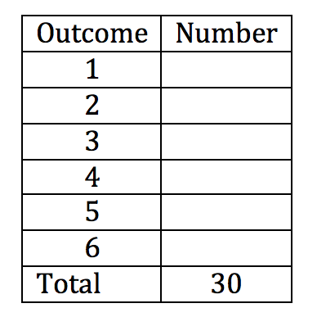
Okay, on your paper, write down a table like this and label it, then fill in what you expect should be the outcomes of 30 tosses of a fair die…
… Now, let’s see what you have put…

Slide 25
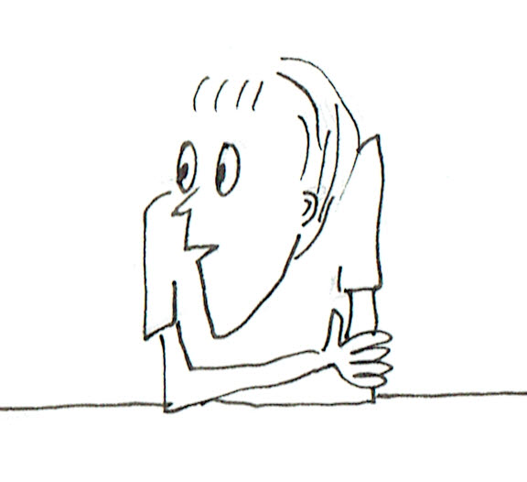
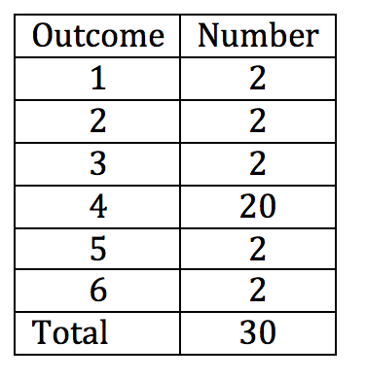
This is because 4 is my favourite number, so it will come up most.
But that would be a biased die. It couldn’t be fair because the chance for 4 would be 2/3, not 1/6.

Slide 26
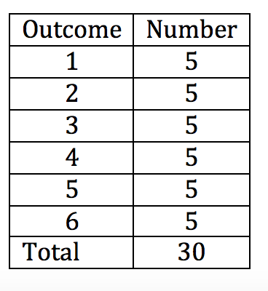
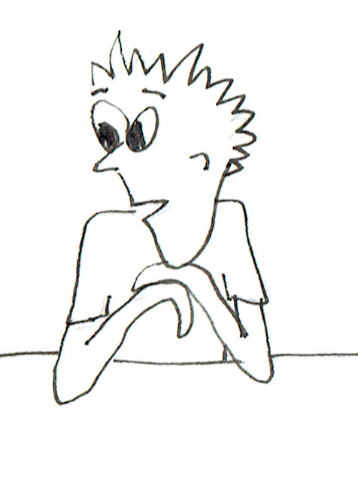
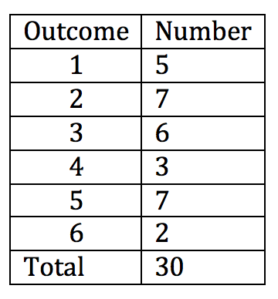
But that’s too good. There would be random variation even with 30. I think it would be more like this.
I think it has to be even to be fair.
There would be one far out and some near to 5.

Slide 27
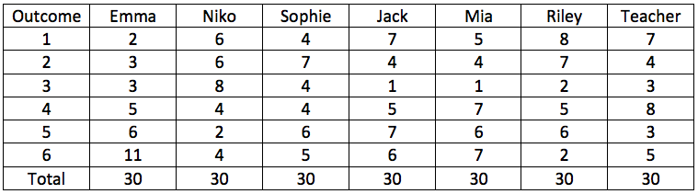
Okay, let’s see what happens when we actually each roll a die 30 times…
Comments? Were you careful not to toss in a biased way?
Would you call the results random?

Slide 28
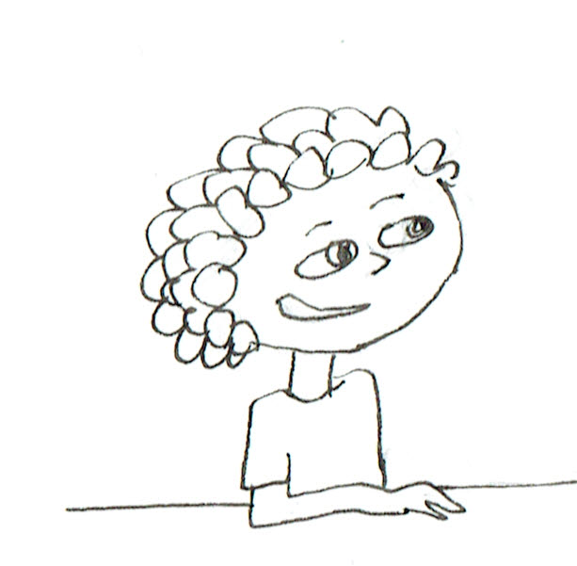
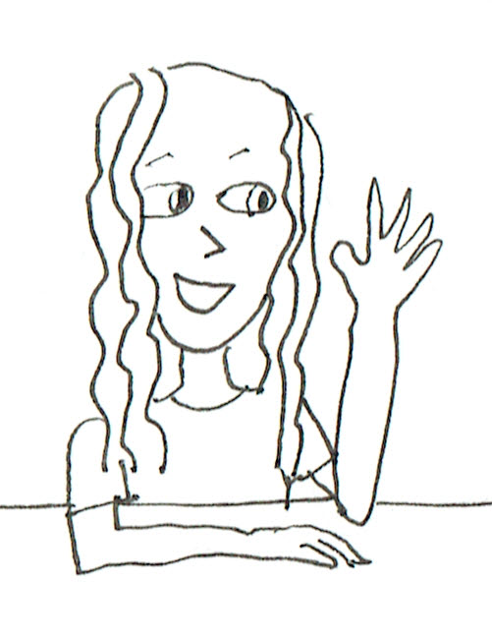
Look, there aren’t many came up exactly 5 times. That’s what surprises me.
And look! I didn’t cheat and I got 11 6s.
Mine is the best because it is the most even.

Slide 29
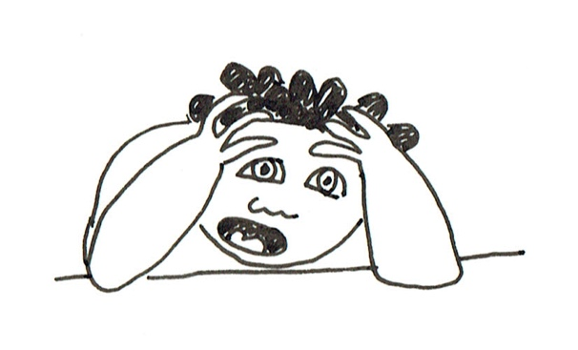
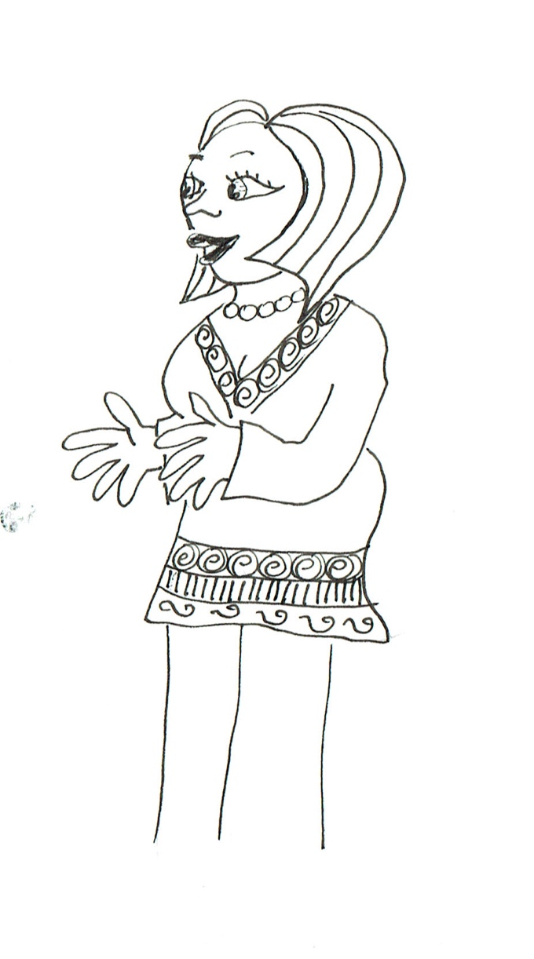
Maybe you should change your favourite number to 3!
My favourite number has let me down!
Or maybe you need to reconsider how you deal with the variation and expectation in chance events!

Slide 30

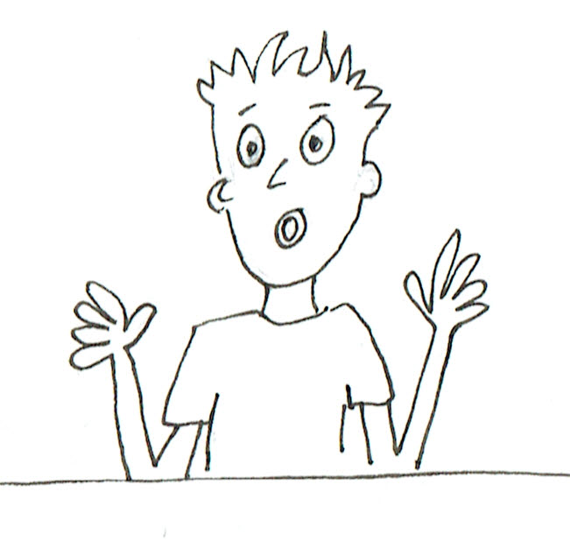
Now I want you to think of the variation in your results. To be totally fair like Sophie said, each number would have to come up 1/6th of the time. What is your fraction for 6s, Emma?
Mine is 11/30, but how do I compare it with 1/6?
Could we use decimals or percentages? It’s easier than finding a common denominator!

Slide 31
Okay, use your calculators? What do you get?
11/30 = 0.3666666… or 36.666666…%. Can we round it to 37%?
Of course!
And 1/6 = 0.1666666… or about 17%.
So what is the difference?
20%.

Slide 32

And my biggest count is only 7/30, which turns into 0.2333333… or about 23%.
My difference is only 6%!
So does one of mine!
And one of mine has 0% difference!

Slide 33
It seems like quite a bit of variation, doesn’t it?
Would it be better if we put them all together?
Right, how many tosses would we have all together?
210
Okay, you can each add up a face and check each other and give us the percentage as well.

Slide 34
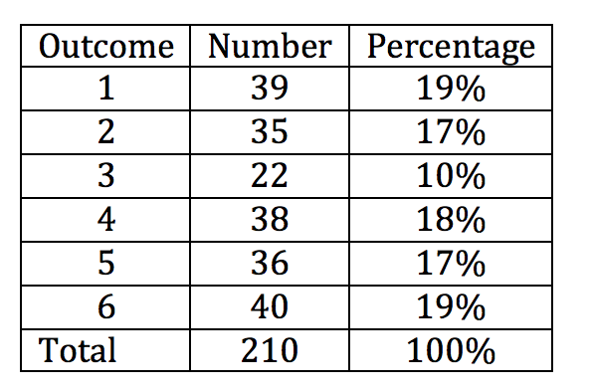

… What do you think now? How many of each should we expect?
It still isn’t very even. There are nearly twice as many 6s as 3s. The difference is 18 and Emma’s difference of most and least was only 9. So it is worse when we do more trials!
35

Slide 35
Aha, but how do the percentages compare with the 17% we expect?
The biggest difference in the percentages from 17% is 7% for the 3s but that is much less than the 20% difference for the 6s that Emma got when she did 30 rolls.
So it really isn’t too bad. Except for 3, the percentages are all near 17%.

Slide 36
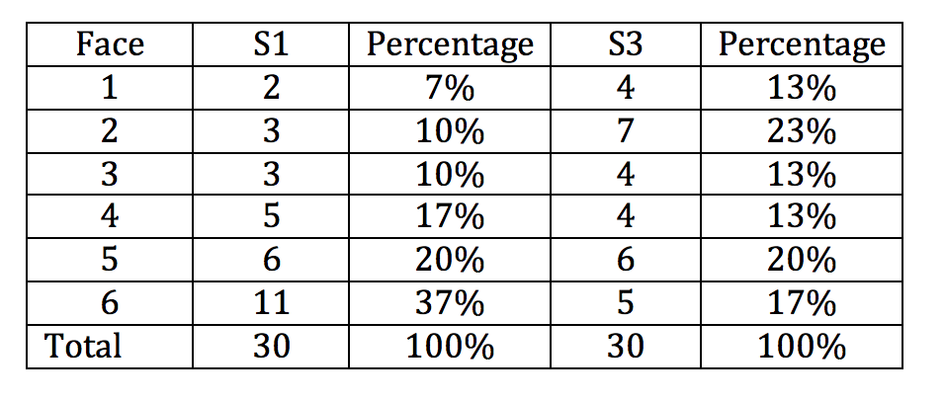
Well, let’s see how these differences in percentage compare with the differences for Emma and Sophie.
Maybe visualisation will help.
Let’s plot the data to get a better feeling for how much variation is in each one.

Slide 37
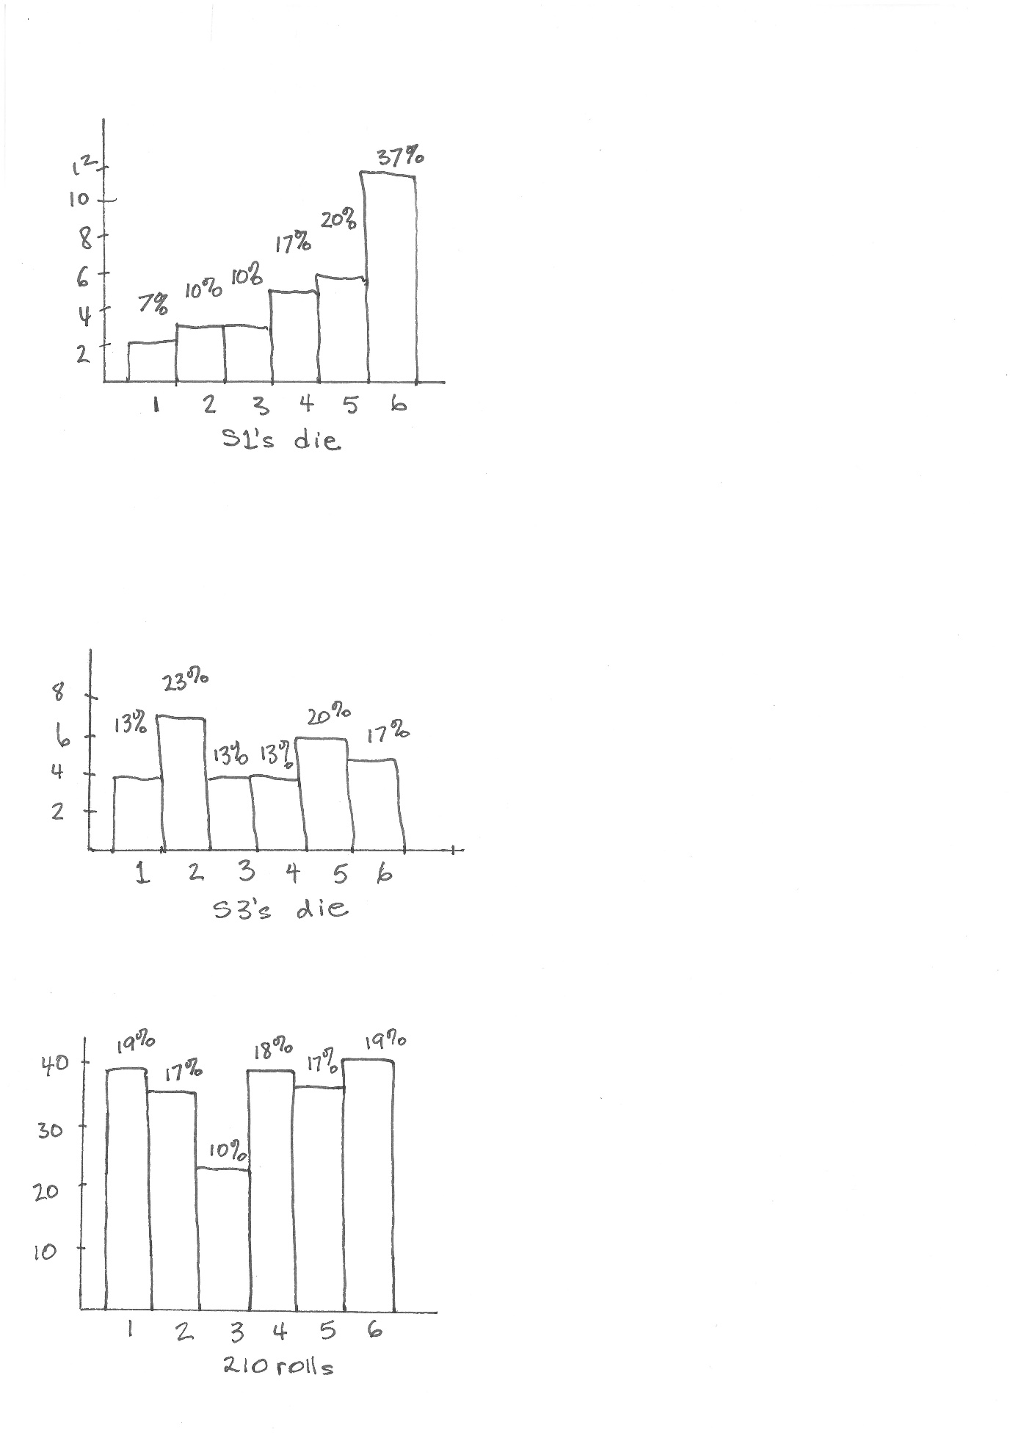
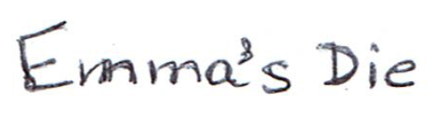
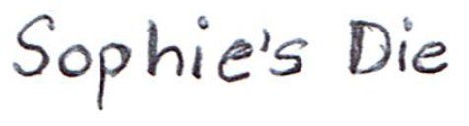
Gee, the variation shows up like this, doesn’t it? Let’s plot the total of 210 tosses.

Slide 38
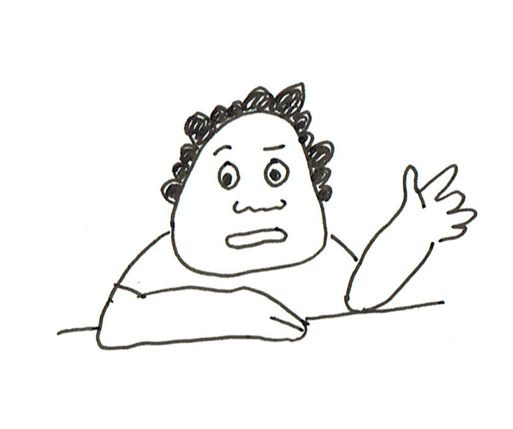
The scale is different but except for the 10%, the results look closer to 17% than when we did only 30 tosses each.
Would the percentages get closer to 17% if we did 600 tosses instead of 210?

Slide 39
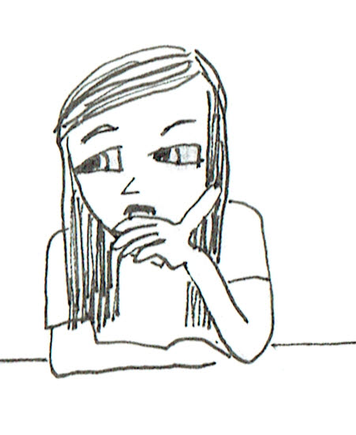
Good question. It would take us quite a while to do 600 trials but we have some software with a pseudo-random generator here that can do it for us.
It is called TinkerPlots and has a Sampler that can roll a die as many times as we ask it to. Have a look on the white board as I use my computer. If we do 600 rolls, what do we expect from a fair random generator?
100 on each side.

Slide 40
What is the largest difference between the counts and 100? How does it compare to the largest difference when we did 210 trials?
116 – 100 = 16.
For 210 trials it was 35 – 22 = 13. Not much difference in the difference!!
But what about the difference in the percentages from 17%?

Slide 41
Have a look at this format.
It came down from 7% to 2%!
Now let’s do 6000 trials and see what happens.

Slide 42
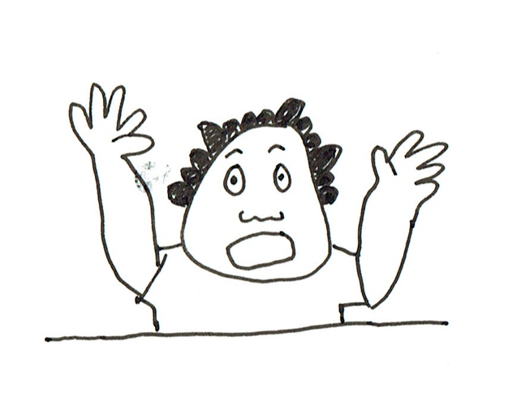
The biggest difference in the count from 1000 is 50 but it is only 1% in percentage. Try 60000!!

Slide 43
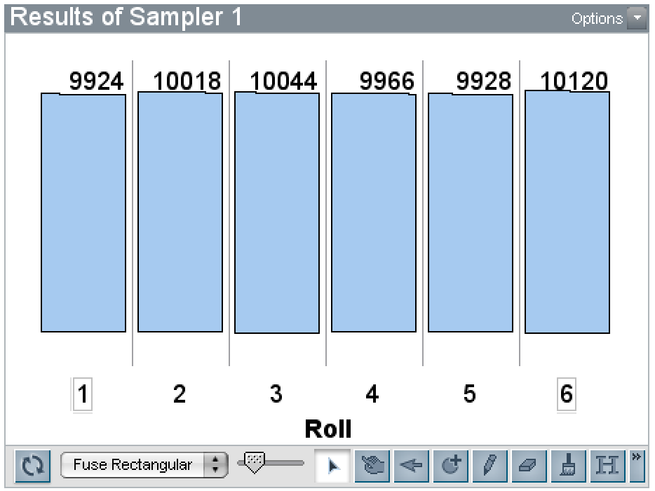
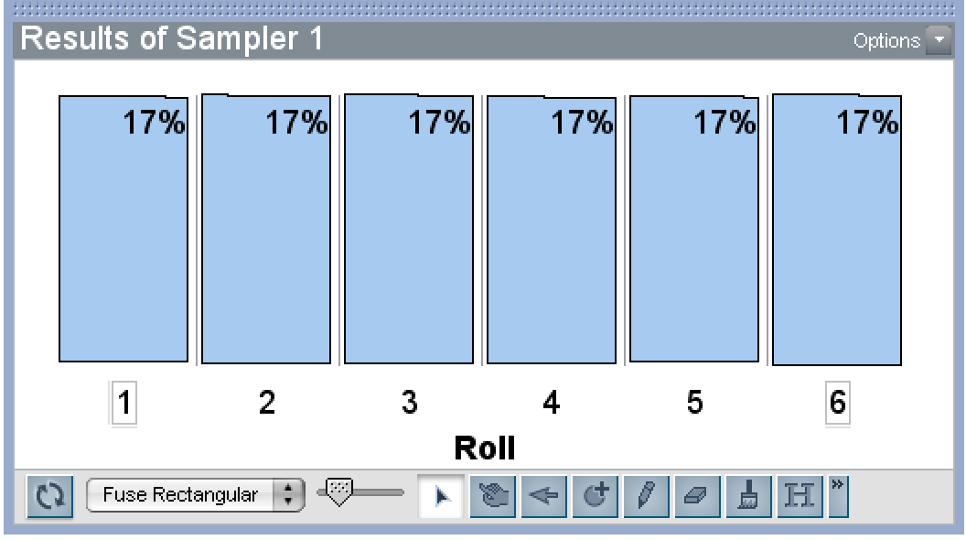
Okay
Wow! The biggest difference from 10000 is 120 but the percentages come out even!

Slide 44
If you roll a fair die long enough the outcomes will match what we expect if we just say, ‘it has 6 sides and is fair!’ The chance is 1/6 for each number.
What have we learned about rolling dice and about Variation and Expectation?
But along the way there can be lots of variation from 1/6.
Because of all of the random variation, it takes a long time, lots of trials, before we reach the expected values.

Slide 45
I learned that an expectation has a variation but there will always be a common expectation. A variation could be decreased when the number of rolls is increased.
Who can give us a general summary?
Yes, this seems to fit out die-tossing scenario but maybe not a common expectation for footy scores.
I learned that expectation and results have a variation. The more number of trials conducted, the less variation between results and expectation.
Well done, both of you.

Slide 46
And what do we call this whole process?
RANDOM!!!
RANDOM!!!
And it starts with variation and ends with the expectation!
Emma Niko Sophie Jack Mia Riley

Slide 47

Thinking back over the lesson, the Learning Progression appears to follow these levels.

Slide 48


