Slide 1
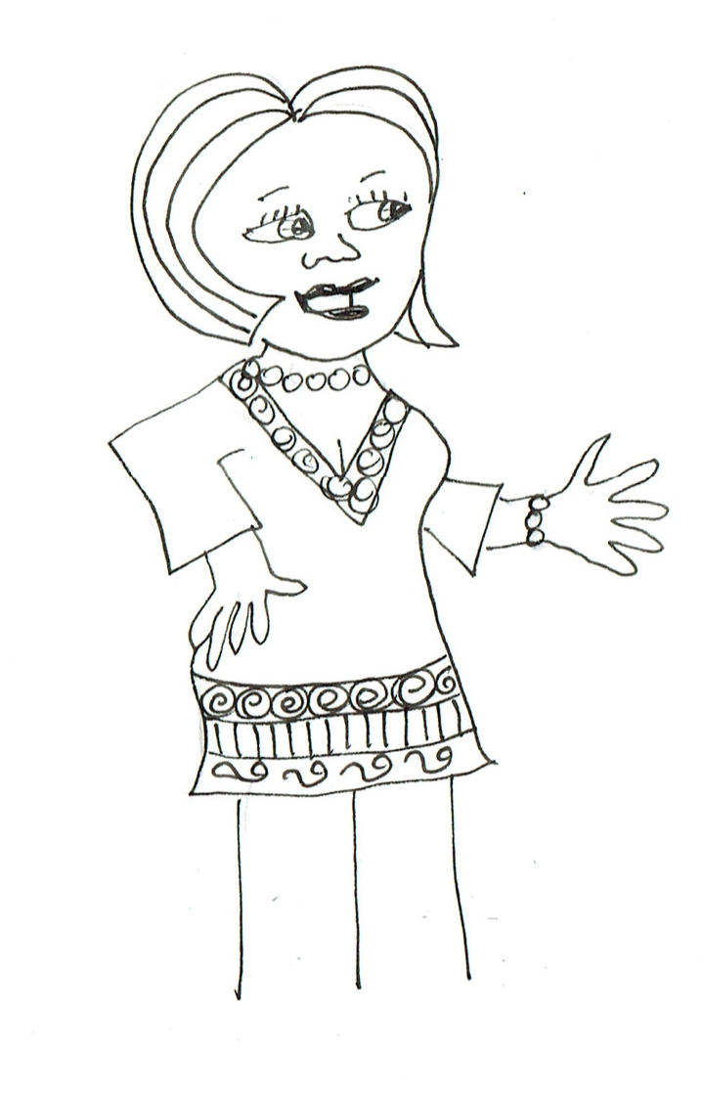
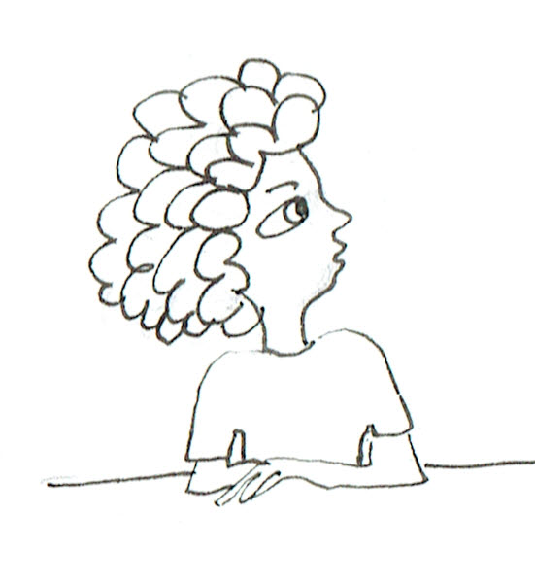

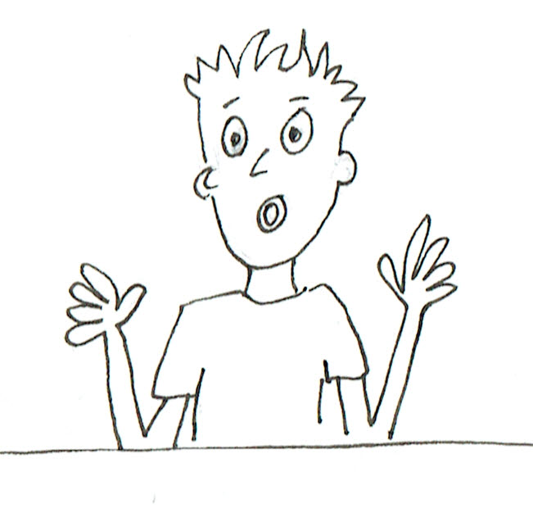
Now I want you to think of the variation in your results. To be totally fair like Sophie said, each number would have to come up 1/6th of the time. What is your fraction for 6s, Emma?
Mine is 11/30, but how do I compare it with 1/6?
Could we use decimals or percentages? It’s easier than finding a common denominator!

Slide 2
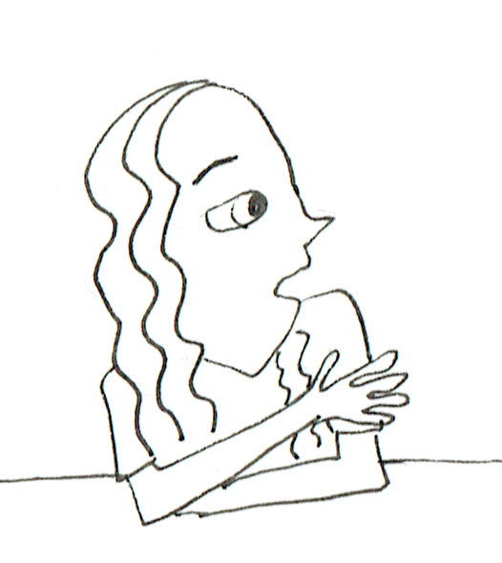
Okay, use your calculators? What do you get?
11/30 = 0.3666666… or 36.666666…%. Can we round it to 37%?
Of course!
And 1/6 = 0.1666666… or about 17%.
So what is the difference?
20%.

Slide 3

And my biggest count is only 7/30, which turns into 0.2333333… or about 23%.
My difference is only 6%!
So does one of mine!
And one of mine has 0% difference!

Slide 4
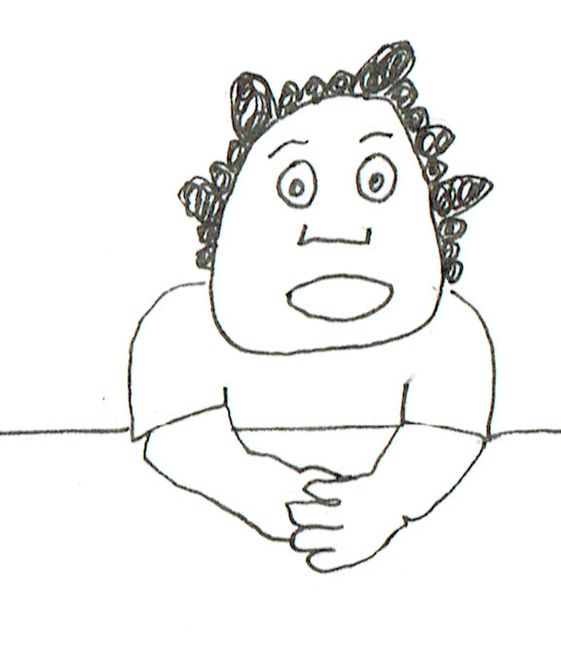
It seems like quite a bit of variation, doesn’t it?
Would it be better if we put them all together?
Right, how many tosses would we have all together?
210
Okay, you can each add up a face and check each other and give us the percentage as well.

Slide 5
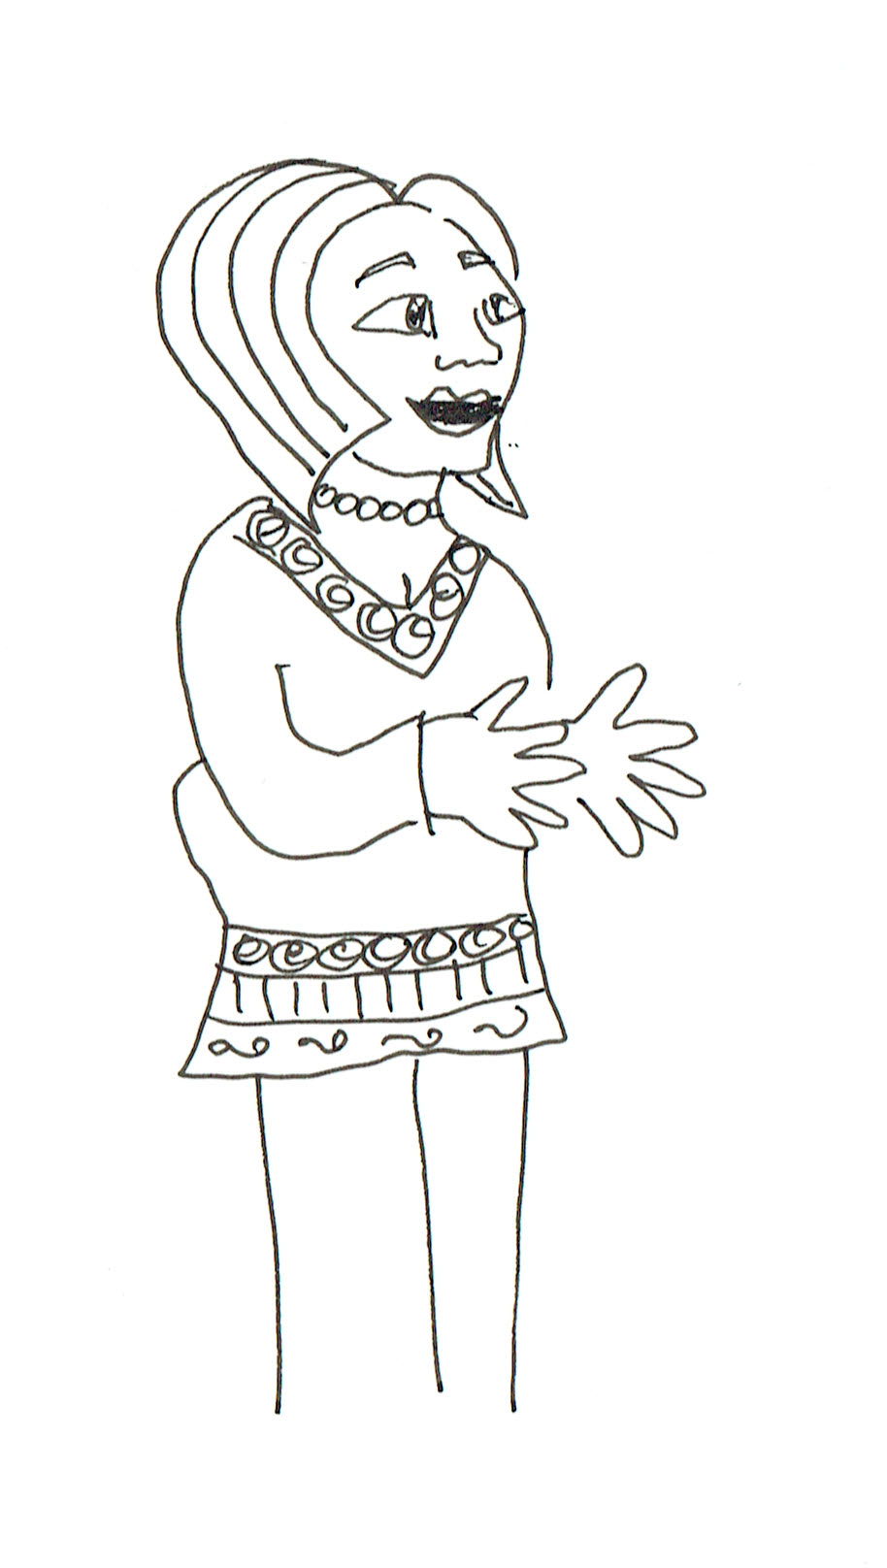
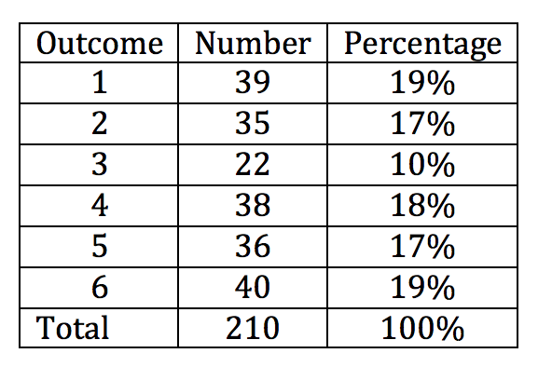
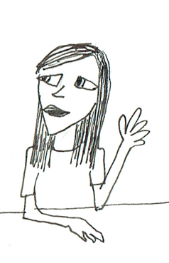

… What do you think now? How many of each should we expect?
It still isn’t very even. There are nearly twice as many 6s as 3s. The difference is 18 and Emma’s difference of most and least was only 9. So it is worse when we do more trials!
35

Slide 6
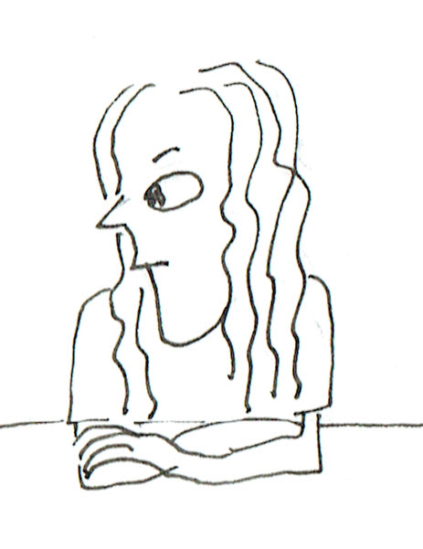
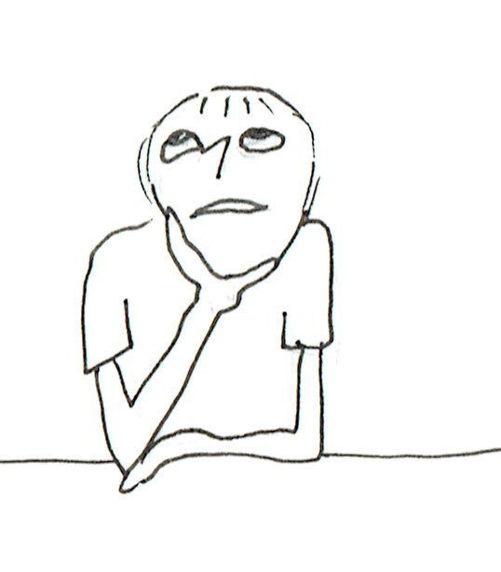
Aha, but how do the percentages compare with the 17% we expect?
The biggest difference in the percentages from 17% is 7% for the 3s but that is much less than the 20% difference for the 6s that Emma got when she did 30 rolls.
So it really isn’t too bad. Except for 3, the percentages are all near 17%.

Slide 7
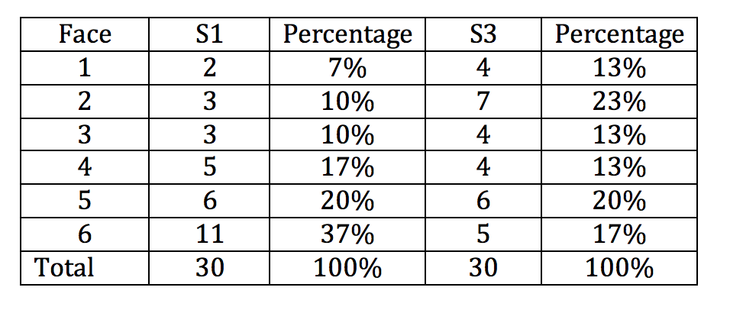
Well, let’s see how these differences in percentage compare with the differences for Emma and Sophie.
Maybe visualisation will help.
Let’s plot the data to get a better feeling for how much variation is in each one.

