Slide 1


What is the largest difference between the counts and 100? How does it compare to the largest difference when we did 210 trials?
116 – 100 = 16.
For 210 trials it was 35 – 22 = 13. Not much difference in the difference!!
But what about the difference in the percentages from 17%?

Slide 2


Have a look at this format.
It came down from 7% to 2%!
Now let’s do 6000 trials and see what happens.

Slide 3
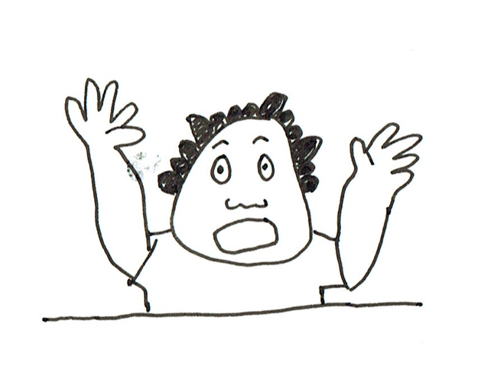
The biggest difference in the count from 1000 is 50 but it is only 1% in percentage. Try 60000!!

